Slide 1


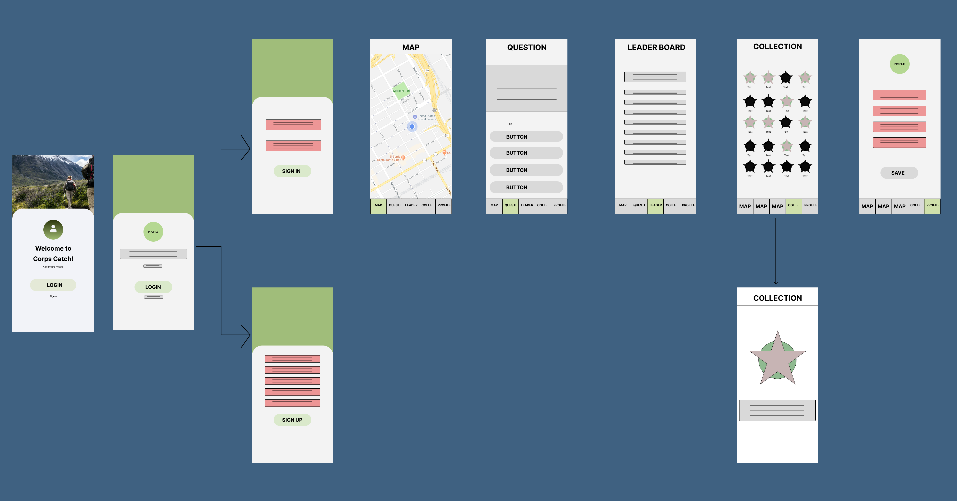
Corps Catch
Le, Kevin Brou, Kouassi Liu, Jianliang Saud, Bijan Komolafe, Seeto
ME/EE/BE… Senior Design
Executive Summary
Experimental Setup
Experimental Results
This application was developed for the US Army Corps in Canton Lake, Oklahoma. The purpose of Corps Catch is to get families outside and promote friendly competition and an incentive for visitors at Canton Lake by implementing a trivia like component to the application. Throughout the various trails there are questions and whenever the user is near a question a pop up will occur on the user's phone. If the user gets all the questions right on the trail the user is awarded a corps coin.
Table 1. Specification Table
Our demo can be viewed using the QR code below: it demonstrates our current application as well as the web portal and testing components
Item # | I | Purpose | Constraints
1 | User Sign-up / Login | Allow app to keep track of users and their progress | Email, Name, Age, Password needed for sign-up. Email and password needed for login
2 | Track User Location | Track user location to ensure that questions pop up at correct location | User must have stable connection
3 | Corp Coins | Provide user with achievement for getting all questions right | User must get all questions right to obtain the corps coin.
4 | Question Difficulty | Keep users of all ages engaged by making question difficulty | User enters their correct age in the sign-up page, and must be able to read and answer questions.
Background
Experimental Test Plan
Conclusions
Since the pandemic families are often inside which can lead to a sedentary lifestyle. Corps Catch would like to change that and encourage and incentivize families to be active outdoors. It is an application with the intention of getting families active, allowing them to work collaboratively and spending quality time outdoors.
For this application we utilized Flutter, Firebase, FlutterFlow, and Figma. Flutter allows the application to be available to both IOS and Android Users. We used Figma to create and visualize the page layouts within the application. FlutterFlow allowed us to create the user-interface quicker, as well as connect with Firebase with ease allowing us to develop quicker. The drawback to this is that the code generated by FlutterFlow is messy and harder to debug and customize.
Our project is still under development and the final product will be released on April 28. Our client is satisfied with the progression of our application, and as we wrap up the development if we are not able to get the user location and make question pop up we will move that function of the app to future plans, and we will opt for creating a timer and having the user answer a question every 10-15 minutes on the trail.
Future plans include a friend system where users can add their friends and see their coins, and a custom trail where a user can create a trail with custom questions scattered throughout the trail.
Figure 1. App Flow designed in Figma
References

